Slide 1
Notes:
Topics:
The if Statement
The if-else Statement
Comparing Strings
Nested Decision Structures and the if-elif-else Statement
Logical Operators
Boolean Variables

Slide 2
The if Statement
Control structure: logical design that controls order in which set of statements execute
Sequence structure: set of statements that execute in the order they appear
Decision structure: specific action(s) performed only if a condition exists
Also known as selection structure
Notes:
Sequence and decision structures are two types of control structures. Although the sequence structure is heavily used in programming, it cannot handle every type of task. This is because some problems simply cannot be solved by performing a set of ordered steps, one after the other. Decision structures execute a set of statements only under certain circumstances.

Slide 3
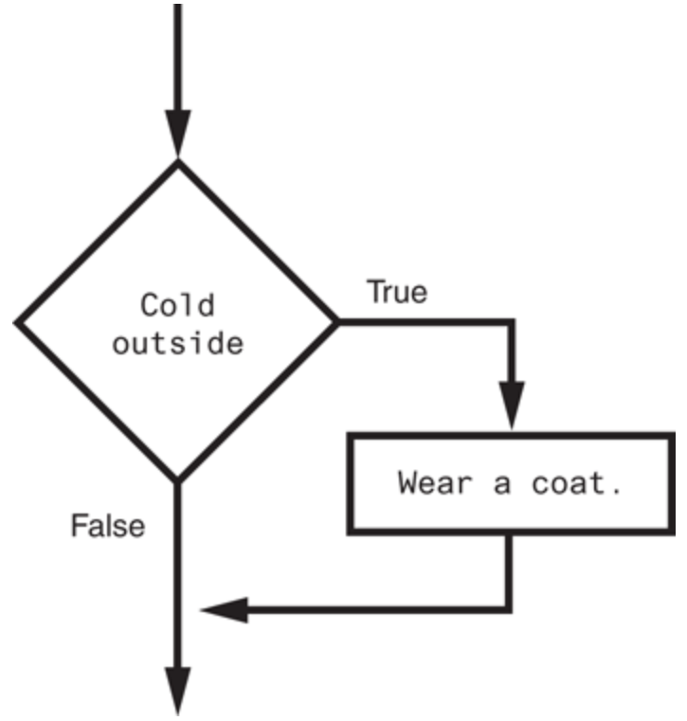
The if Statement (cont’d.)
In flowchart, diamond represents true/false condition that must be tested
Single alternative decision structure: provides only one alternative path of execution
If condition is not true, exit the structure
Notes:
Actions can be conditionally executed - Performed only when a condition is true

Slide 4
The if Statement (cont’d.)
Python syntax:
if condition:
Statement
Statement
Example 1:
if “GAATTC” in “ATCTGGAATTCATCG”:
print(“EcoRI site is present”)
Example 2:
if “GAATTC” not in “AAAAAAAAA”:
print(“EcoRI will not cut the sequence”)
Notes:
First line known as the if clause
Includes the keyword if followed by condition
The condition can be true or false
When the if statement executes, the condition is tested, and if it is true the block statements are executed. otherwise, block statements are skipped

Slide 5
Boolean Expressions and Relational Operators
Boolean expression: expression tested by if statement to determine if it is true or false
Example: a > b
true if a is greater than b; false otherwise
Relational operator: determines whether a specific relationship exists between two values
Example: greater than (>)

Slide 6
Boolean Expressions and Relational Operators (cont’d.)
>= and <= operators test more than one relationship
It is enough for one of the relationships to exist for the expression to be true
== operator determines whether the two operands are equal to one another
Do not confuse with assignment operator (=)
!= operator determines whether the two operands are not equal

Slide 7
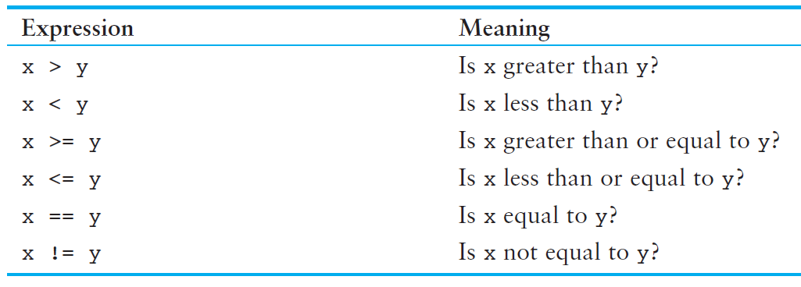
Boolean Expressions and Relational Operators (cont’d.)

Slide 8
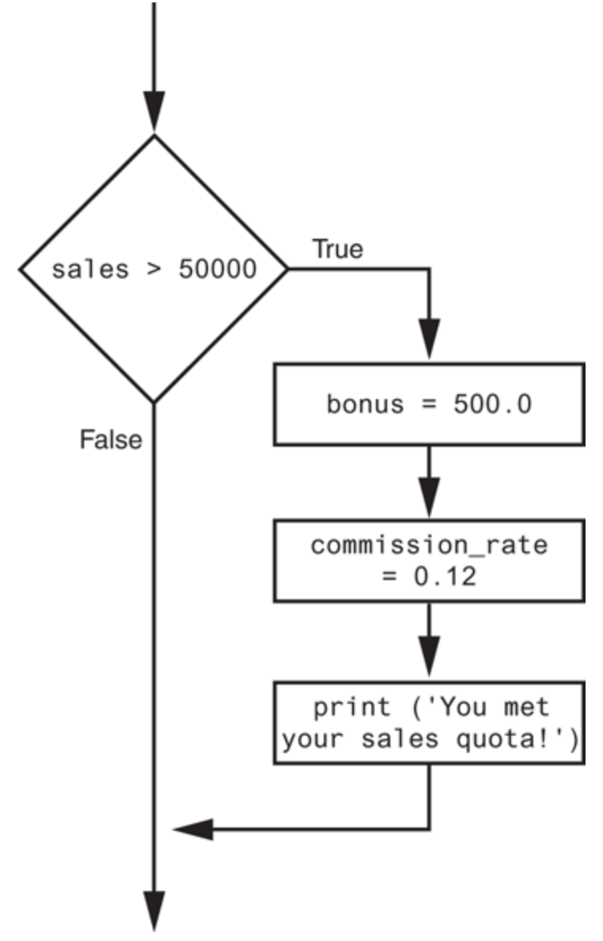
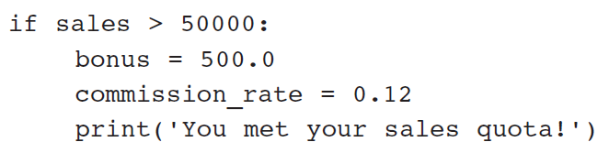
Boolean Expressions and Relational Operators (cont’d.)
Example: using a Boolean expression with the > relational operator
Notes:
Any relational operator can be used in a decision block
Example: if balance == 0
Example: if payment != balance

Slide 9
Knowledge Check
Write an if statement that assigns 0 to bonus and prints “Uh oh!” if sales is equal to 0. Draw out the corresponding flowchart.
Notes:
If sales == 0:
bonus = 0
print(“Uh oh!”)

Slide 10
The if-else Statement
Dual alternative decision structure: two possible paths of execution
One is taken if the condition is true, and the other if the condition is false
Syntax: if condition:
statements
else:
other statements
if clause and else clause must be aligned
Statements must be consistently indented

Slide 11
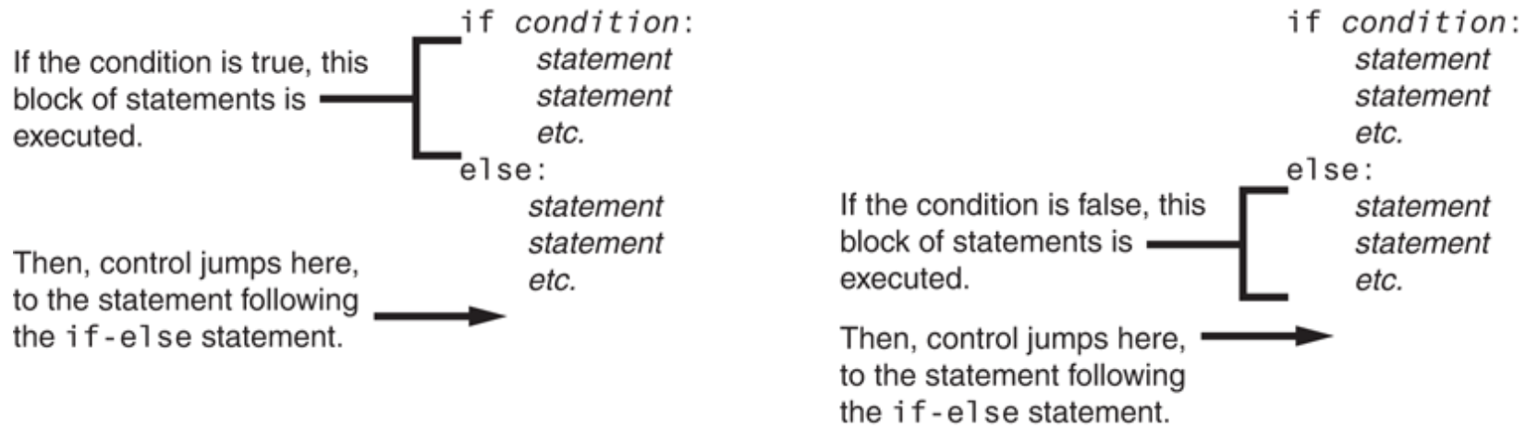
The if-else Statement (cont’d.)

Slide 12
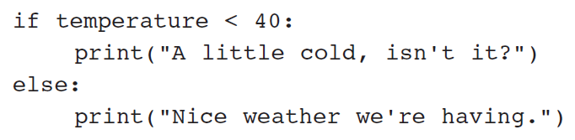
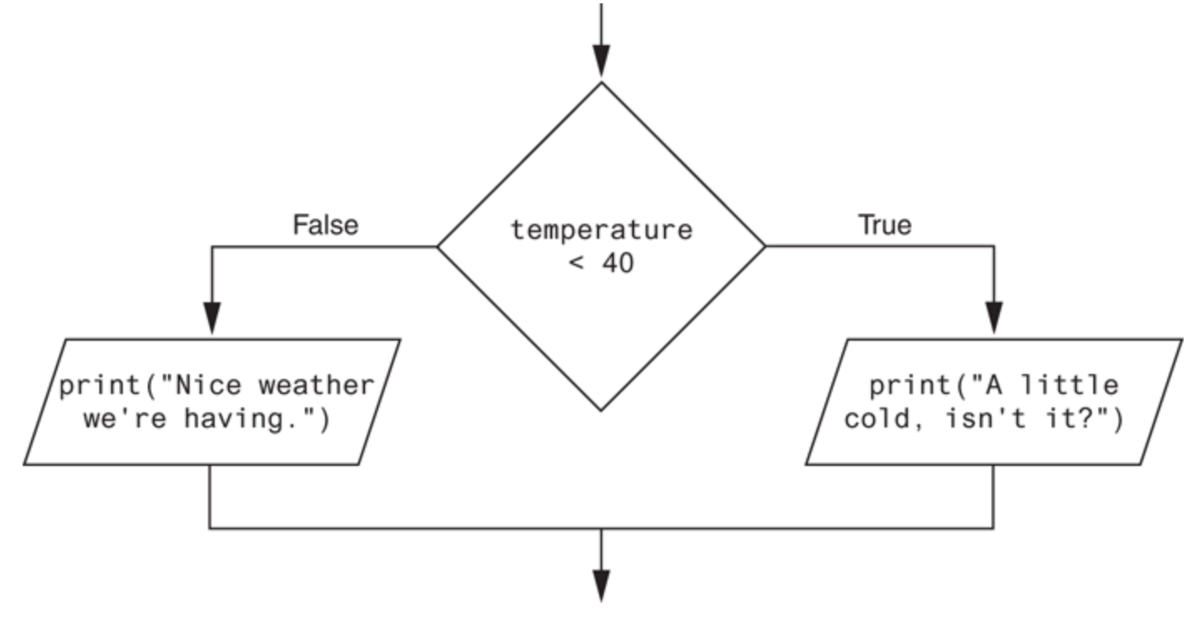
The if-else Statement (cont’d.)

Slide 13
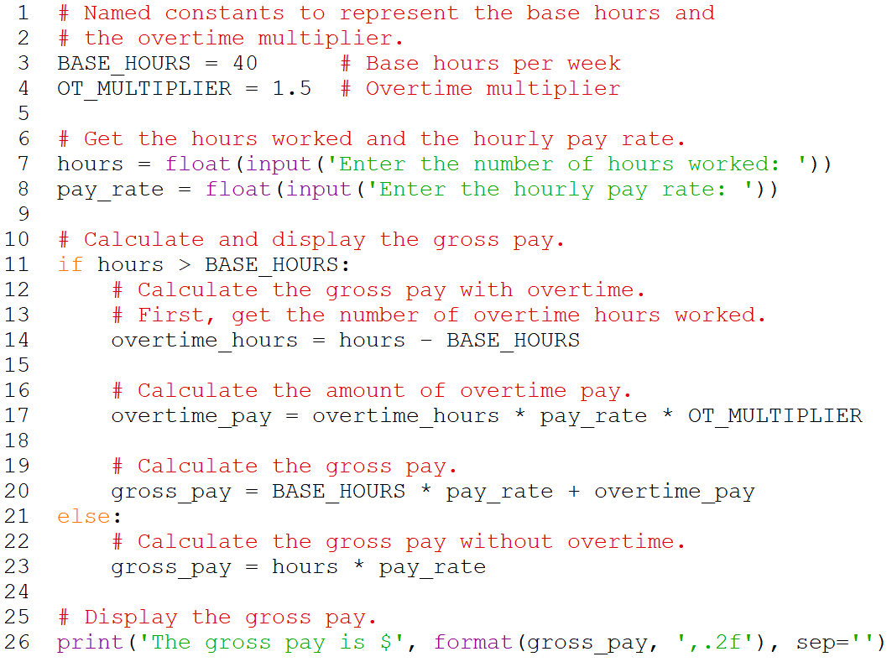
Payroll Example
Notes:
Example output:
Enter the number of hours worked: 40
Enter the hourly pay rate: 20
The gross pay is $800.00.
Enter the number of hours worked: 50
Enter the hourly pay rate: 20
The gross pay is $1,100.00.

Slide 14
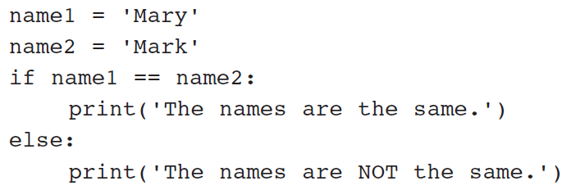
Comparing Strings
Strings can be compared using the == and != operators
String comparisons are case sensitive

Slide 15
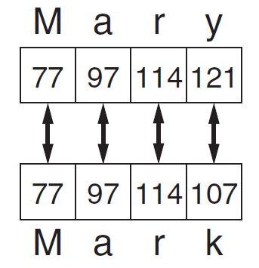
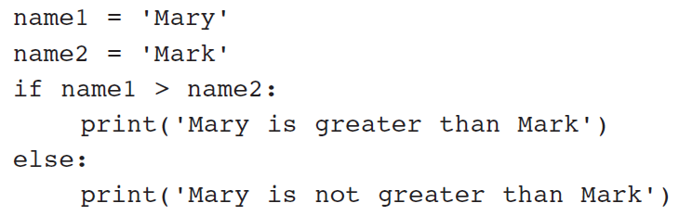
Comparing Strings (cont’d.)
Strings can be compared using >, <, >=, and <=
Compared character by character based on the ASCII values for each character
If shorter word is substring of longer word, longer word is greater than shorter word

Slide 16
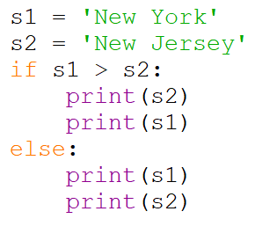
Knowledge Check
What is the output?
Notes:
ANS:
New Jersey
New York

Slide 17
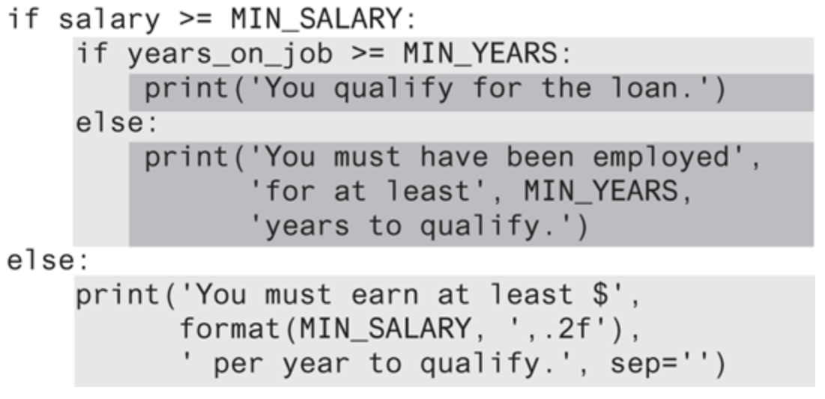
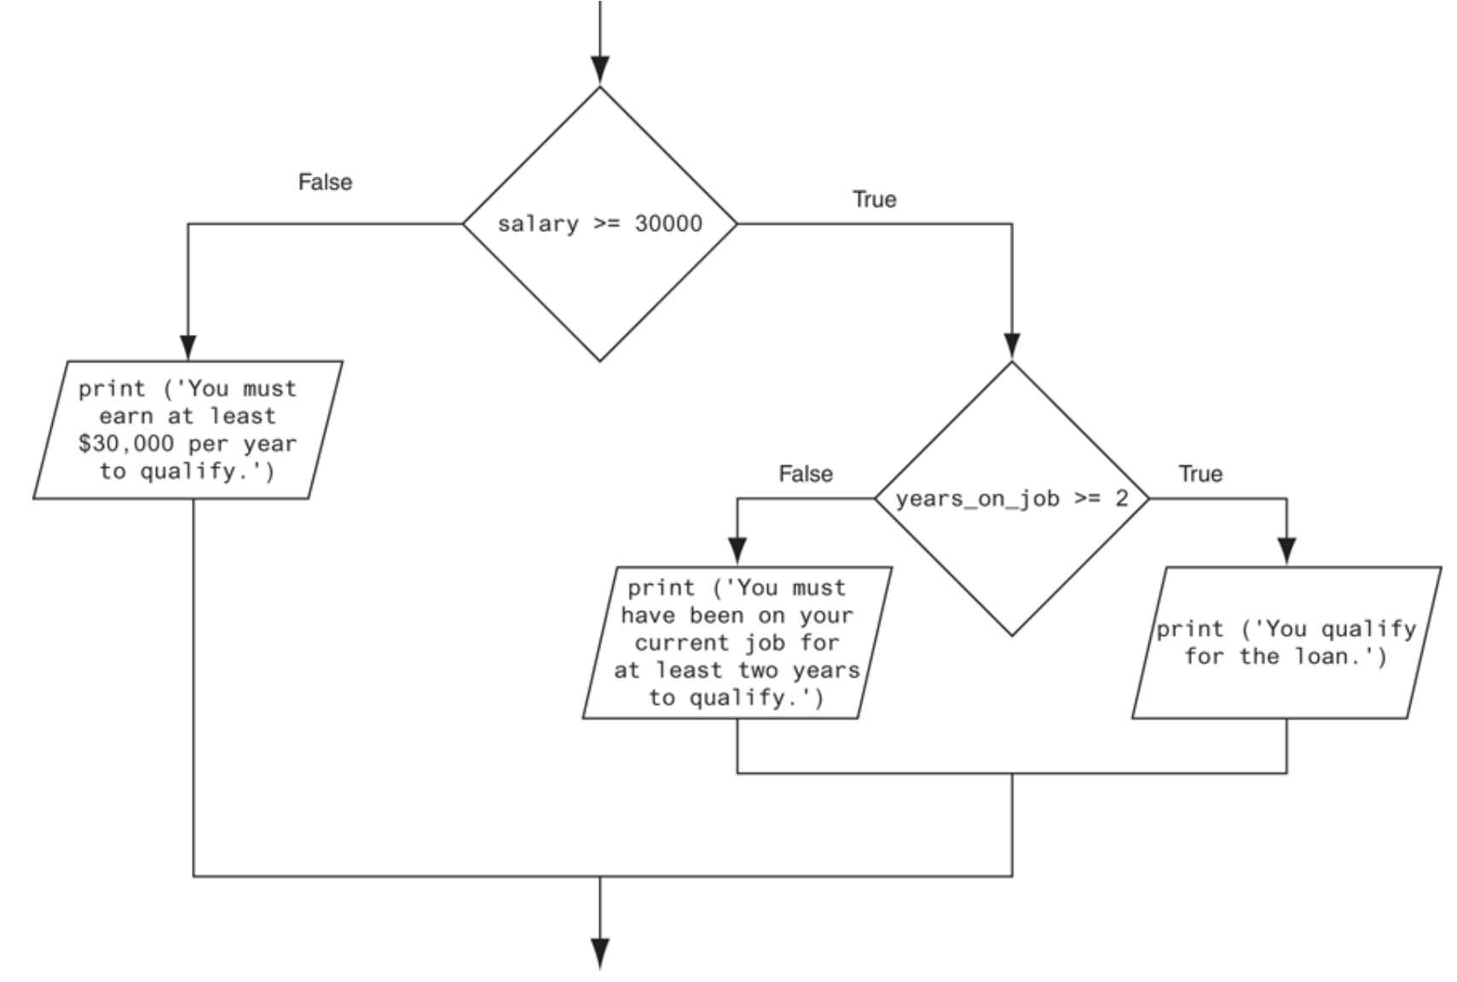
Nested Decision Structures
A decision structure can be nested inside another decision structure
Example: loan qualification
Notes:
Nested decision structures used to test more than one condition.
Ex: Determine if someone qualifies for a loan, they must meet two conditions:
Must earn at least $30,000/year
Must have been employed for at least two years
Check first condition, and if it is true, check second condition

Slide 18
Nested Decision Structures (cont’d.)
Important to use proper indentation in a nested decision structure
Important for Python interpreter
Makes code more readable for programmer
Rules for writing nested if statements:
else clause should align with matching if clause
Statements in each block must be consistently indented

Slide 19
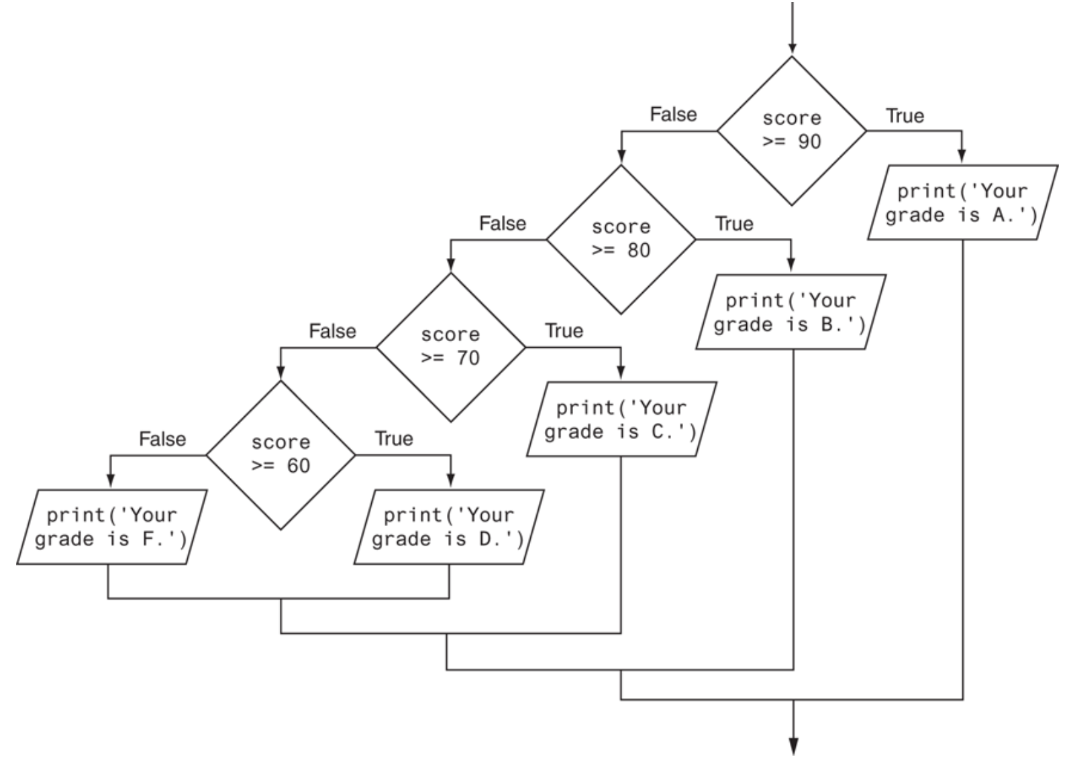
Nested Decision Structures (cont’d.)
Example: grading program

Slide 20
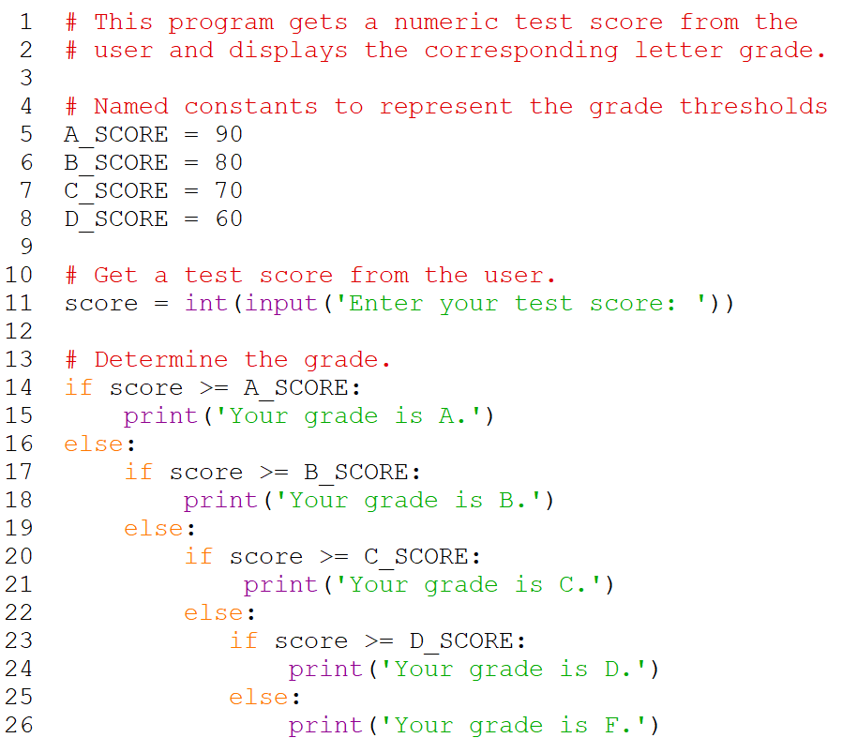
Nested Decision Structures (cont’d.)
Example: grading program (cont’d.)

Slide 21
The if-elif-else Statement
if-elif-else statement: special version of a decision structure
Makes logic of nested decision structures simpler to write
Can include multiple elif statements
Syntax:
if condition_1:
statement(s)
elif condition_2:
statement(s)
elif condition_3:
statement(s)
else
statement(s)
Insert as many elif clauses
as necessary.

Slide 22
The if-elif-else Statement (cont’d.)
Alignment used with if-elif-else statement:
if, elif, and else clauses are all aligned
Conditionally executed blocks are consistently indented
if-elif-else statement is never required, but logic easier to follow
Can be accomplished by nested if-else
Code can become complex, and indentation can cause problematic long lines

Slide 23
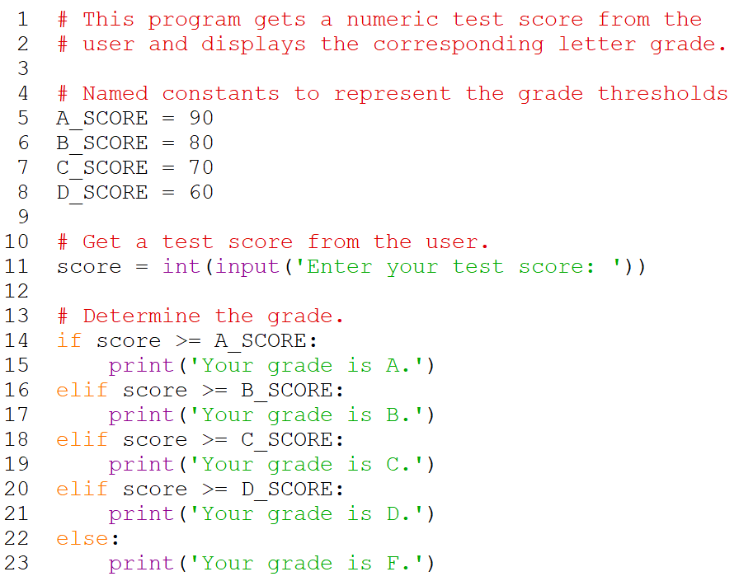
The if-elif-else Statement (cont’d.)
Example: grading program revisited
Notes:
This code works the same as the nested decision structure in lines 14 through 26 of the previous grading program example.

Slide 24
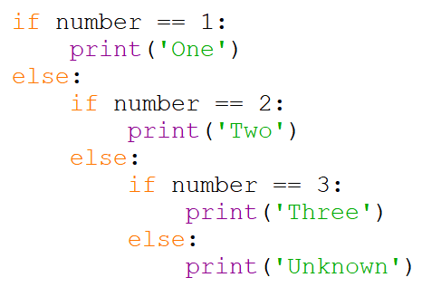
Knowledge Check
Convert the following code to an if-elif-else statement:
Notes:
if number == 1:
print(‘One’)
elif number == 2:
print(‘Two’)
elif number == 3:
print(‘Three’)
else:
print(‘Unknown’)

Slide 25
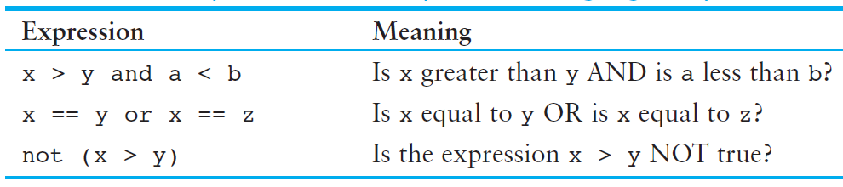
Logical Operators
Logical operators: operators that can be used to create complex Boolean expressions
and, or, and not operators
Notes:
and operator and or operator: binary operators, connect two Boolean expressions into a compound Boolean expression
not operator: unary operator, reverses the truth of its Boolean operand

Slide 26
The and Operator
Takes two Boolean expressions as operands
Creates compound Boolean expression that is true only when both sub expressions are true
Truth table for
the and operator
Example:
Value of the Expression | Expression
false | false and false
false | false and true
false | true and false
true | true and true
Notes:
Can be used to simplify nested decision structures
Short circuit evaluation: deciding the value of a compound Boolean expression after evaluating only one sub expression
For and operator: If the expression on the left side of the and operator is false, the expression on the right side will not be checked. Because the compound expression will be false if only one of the subexpressions is false, it would waste CPU time to check the remaining expression. So, when the and operator finds that the expression on its left is false, it short-circuits and does not evaluate the expression on its right.

Slide 27

The or Operator
Takes two Boolean expressions as operands
Creates compound Boolean expression that is true when either of the sub expressions is true
Truth table for
the or operator
Example:
Value of the Expression | Expression
false | false and false
true | false and true
true | true and false
true | true and true
Notes:
Can be used to simplify nested decision structures
For or operator: If the expression on the left side of the or operator is true, the expression on the right side will not be checked. Because it is only necessary for one of the expressions to be true, it would waste CPU time to check the remaining expression.

Slide 28
The not Operator
Takes one Boolean expression as operand and reverses its logical value
Truth table for the not operator
Example:
Value of the Expression | Expression
false | true
true | false
Notes:
Sometimes it may be necessary to place parentheses around an expression to clarify to what you are applying the not operator
First, the expression (temperature > 100) is tested and a value of either true or false is the result. Then the not operator is applied to that value. If the expression (temperature > 100) is true, the not operator returns false. If the expression (temperature > 100) is false, the not operator returns true. The previous code is equivalent to asking: “Is the temperature not greater than 100?”

Slide 29
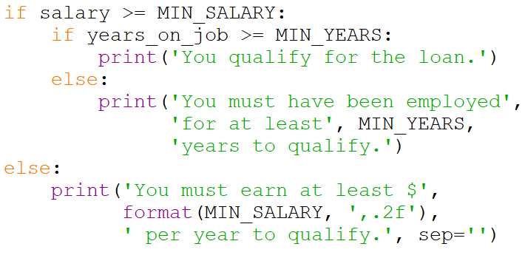
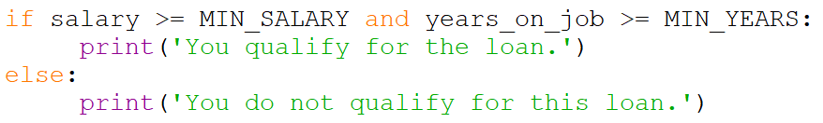
Loan Qualifier Program Revisited
The nested if-else statement…
…can be rewritten simpler as

Slide 30

Checking Numeric Ranges with Logical Operators
To determine whether a numeric value is within a specific range of values, use and
Example: x >= 10 and x <= 20
To determine whether a numeric value is outside of a specific range of values, use or
Example: x < 10 or x > 20

Slide 31
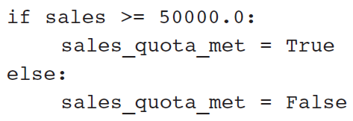
Boolean Variables
Boolean variable: references one of two values, True or False
Represented by bool data type
Commonly used as flags
Flag: variable that signals when some condition exists in a program
Flag set to False → condition does not exist
Flag set to True → condition exists
Example:

Slide 32
Summary
This chapter covered:
Decision structures, including:
Single alternative decision structures
Dual alternative decision structures
Nested decision structures
Relational operators and logical operators as used in creating Boolean expressions
String comparison as used in creating Boolean expressions
Boolean variables

Slide 33
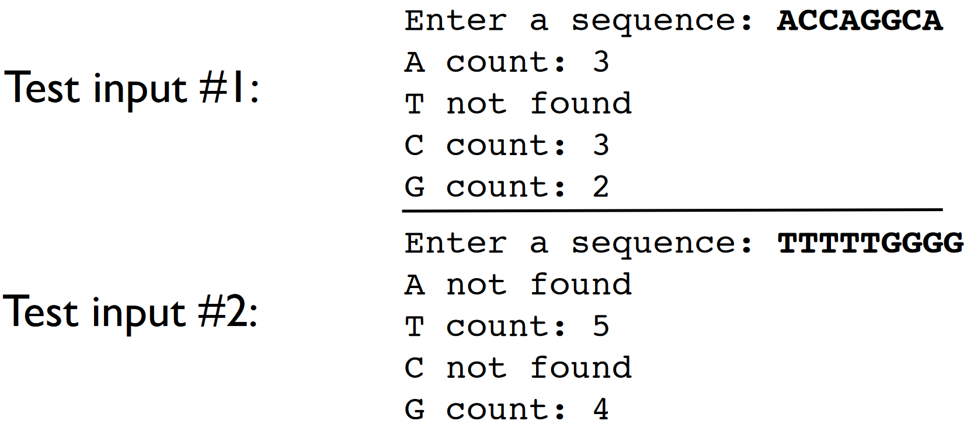
In-class Exercise 2
Write a program that prompts the user for a DNA sequence. If there is an A in the sequence, print the number of times it appears in the sequence. If it does not exist, print “A not found”. Do the same for T, C, and G.
Notes:
Ask students to design flowchart first before attempting to code the program.

